Slide 1

Online Music Streaming App
Nirvana
- a song for every mood

Slide 2
Contents
Introduction
Dataset
Entities & Attributes
Conceptual Model
Logical Model
Application demo
Use cases
Area of improvements
Challenges

Slide 3
INTRODUCTION
Our project is aimed at developing a robust and user-friendly online music streaming platform. Users can access a limited music catalogue, create playlists, and manage their profiles with 2 user roles users and administrators.
Evolving landscape of digital entertainment
Passion for music and desire to create a platform that caters diverse tastes and preferences.
aim to contribute to the ever-expanding realm of digital music, fostering a sense of community and discovery for music enthusiasts around the globe.

Slide 4
Data Set
Tables used in the application:
User
Song
Playlist
User Interaction
User Profile
Analytics
Administrator

Slide 5
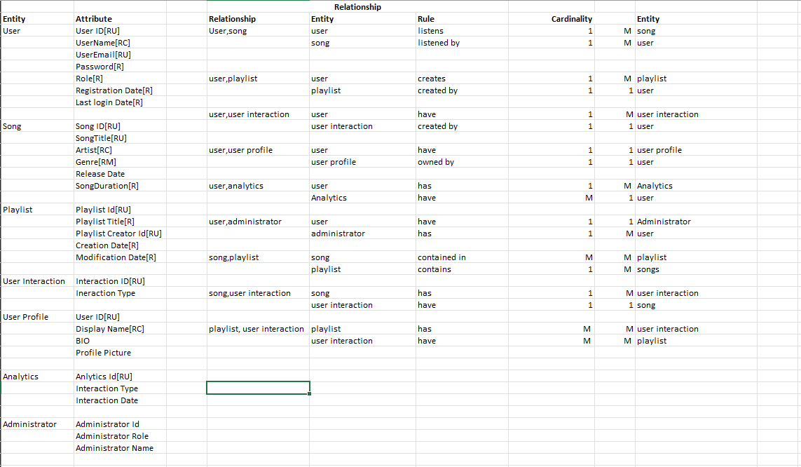
Entities & Attributes

Slide 6
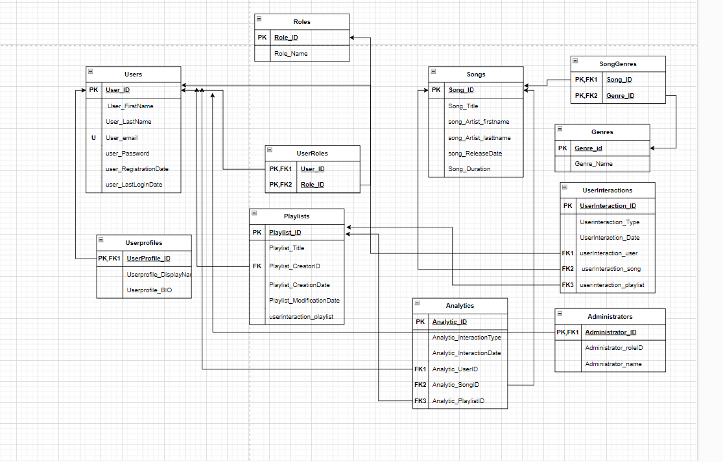
Conceptual Model
Conceptual representation of Entities and Attributes

Slide 7
Logical Model
Logical representation of Entities and Attributes with keys and relations between them.

Slide 8

Application Demo

Slide 9
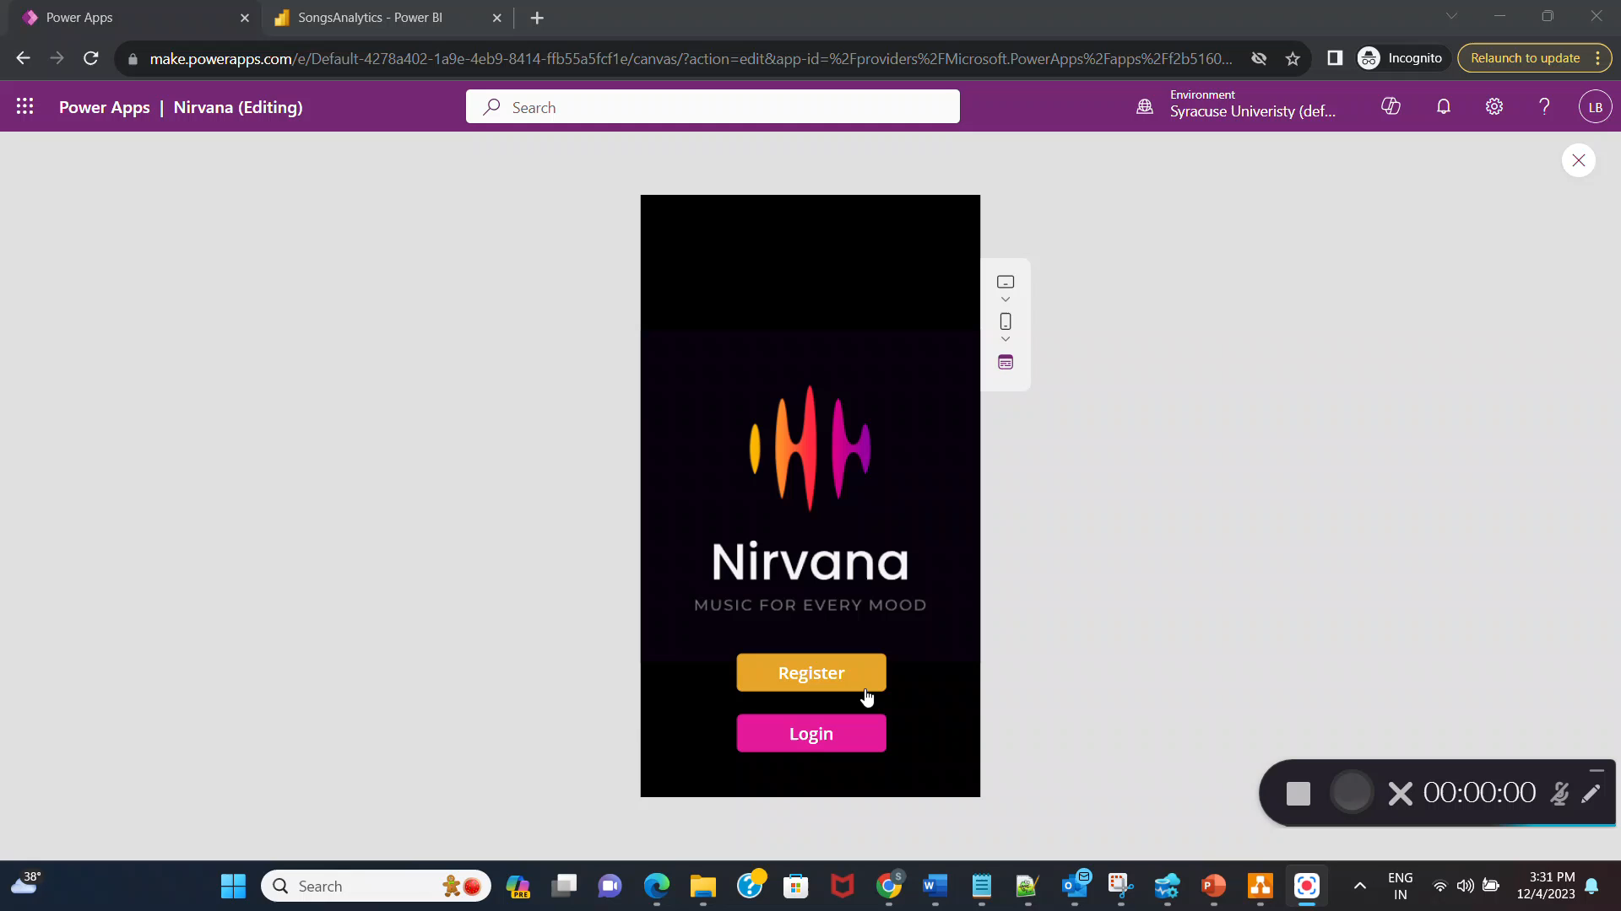

Slide 10
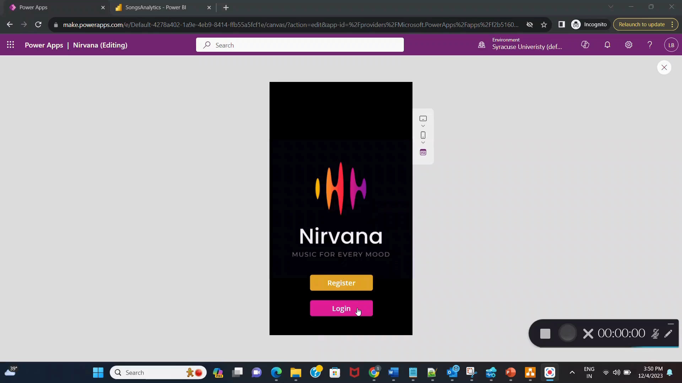

Slide 11
Use cases
Music Catalogue Management
Search and Discovery
User interactions
Analytics

Slide 12
Area of Improvements
Adding interaction functionality in the User Interface.
Hashing for Authentication details like password.

Slide 13
Challenges
Authenticating User so that it can be directed to user and admin screen respectively.
Redirecting to error screen for invalid credentials.

Slide 14

Thankyou

